Slide 1
Software Engineering and Architecture
Some General Observations
on the Mandatory

Slide 2
Advice for Epsilon
EpsilonStone is the ‘introduce test stub to handle indirect input (a random number)’ exercise
My advice is
  Study the Weekplan 6 kata on one way of how not to do it!
  A Stub is a replacement for the behavior not under test control
    And nothing more
  That is: Make the ‘indirect input algorithm’ as small as possible
    Encapsulate the minimum behavior

Slide 3
From the Trenches

Slide 4
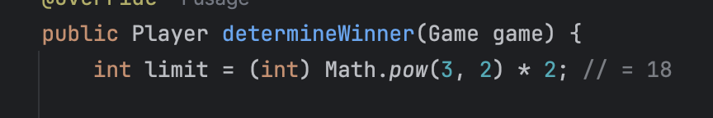
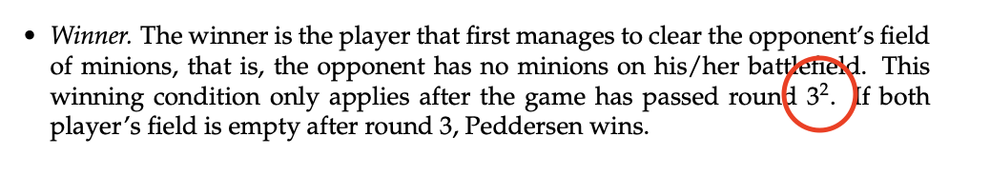
World’s worst footnote ☺

Slide 5
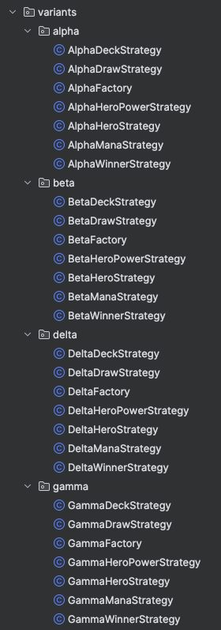
Benefits of this solution?
Critique of this solution?
Morale
  Naming matters
  Duplication matters
Notes:
AlphaDeck better be named Spanish7CardDeck or similar
AlphaDeck is same as BetaDec

Slide 6
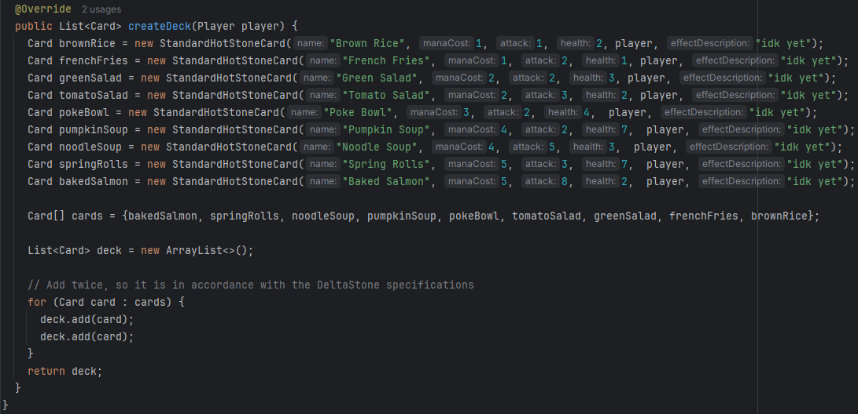
Remember: References
What’s the issue?
Notes:
Same card reference added twice alas the underlying card is the same object

Slide 7
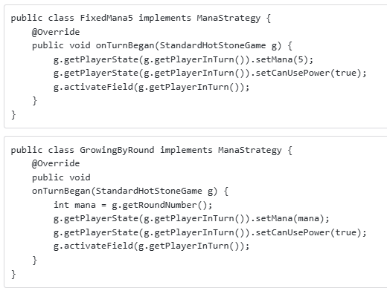
Encapsulate What Varies !
Make your variability points as precise as
possible
  What is the issue here?
Alternative way of
mutating Game?

Slide 8

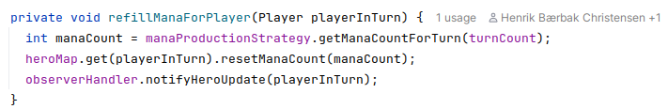
If possible, let Game do it
If you can compute a value in your strategy, then the assignment is in the Game object
  Which is much a more cohesive way
    Game changes game state; instead of some strategy
In StandardGame:

Slide 9
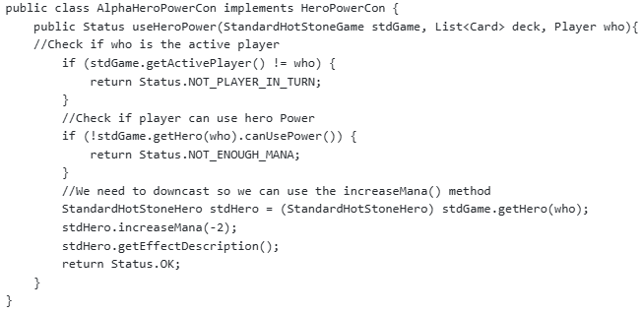
Encapsulate What Varies
Another example
What will the
next strategy
look like?

Slide 10
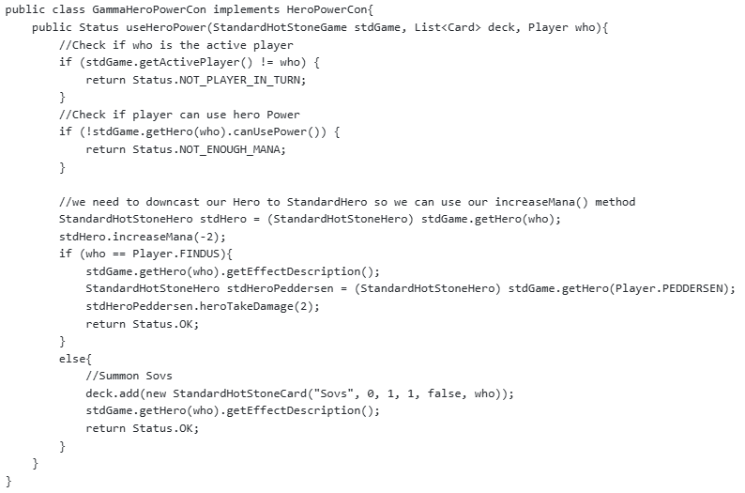
Next Strategy
Code duplication!
ISO 9126: Stability and Changeability capabilities are suffering ☹

Slide 11
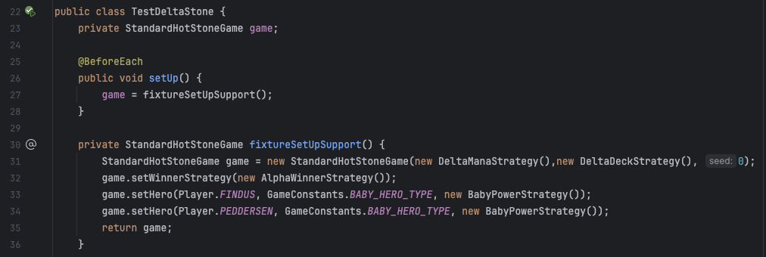
Cohesion? Coupling?
Try to avoid one variant’s requirements affect all others…
Let Game do what the Game must do…
  Cohesion again.
What is the issue (1)? What is the issue (2)?
Notes:
1: seed parameter is only relevant for random decks
2: game is initialized from the outside using setter methods

Slide 12
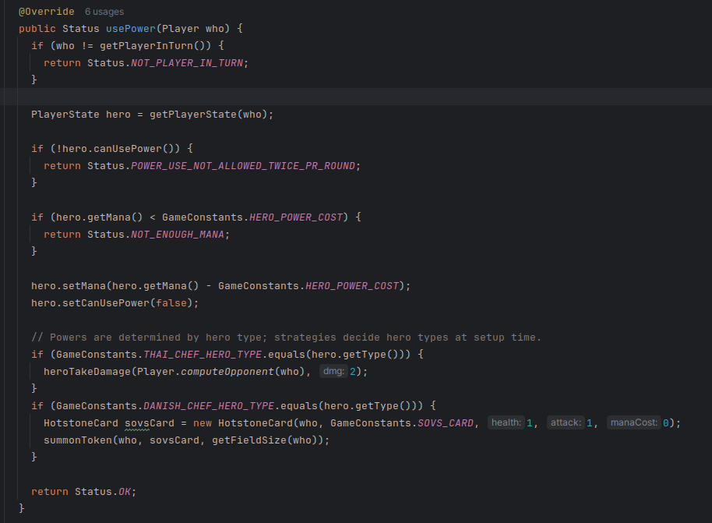
What is the Variability Mgt?
Src-code
copy?
Parametric?
Polymorphic?
Composi-
tional?

Slide 13
“Inner” and “Outer”
Encapsulation:
Who can do what?

Slide 14
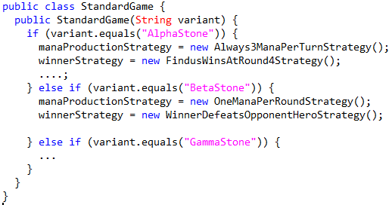
A Previous Year Example
What happens when I want a PiStone variant?
Notes:
It is a parametric solution inside of Game => Constructor is ‘change by modification’.

Slide 15
Last Year Example
Change by modification ☹
    Code must be changed every time a new variant is envisioned…
else if (var.equals(“PiStone”)) {
Notes:
It is a parametric solution inside of Game => Constructor is ‘change by modification’.

Slide 16
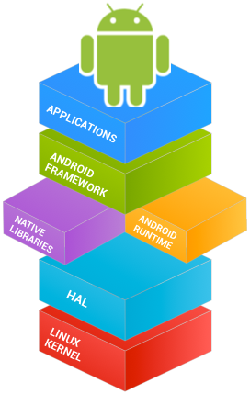
Frameworks
What is the process in the mandatory exercises?
  To use TDD and compositional design to transform an AlphaStone application into a HotStone framework
Frameworks are
  Reusable software designs and implementations
  Must be reconfigurable from the outside
    Just like a TV set or a mobile phone
Example
  Android Google’s smartphone OS
  You do not call Google to make them rewrite their constructor in order to introduce the App for your HCI course, do you!?!

Slide 17
How do I?
Switch from channel TV2 to DR on my Samsung TV set?
  A) Push the Button ‘3’ on the TV’s remote control interface?
  B) Call Samsung to tell them to send a man to re-solder the wire inside the TV set?
This code is using method B

Slide 18
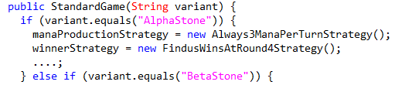
Open/Closed
Open for Extension (I can adapt the framework)
Closed for Modification (But I cannot rewrite the code)
Change by addition, not by modification
So
… is not suitable for implementing frameworks…
  I have to open the TV to solder the wires inside ☹
  You have to call Google to make your HCI project app ☹

Slide 19
So…
Keep StandardGame, (StandardHero, StandardCard), … closed for modification! General enough to handle many variants
  They form the framework that is reused as-is
Allow adapting HotStone to a new variant by addition
  I can code a new DeckBuildingStrategy which allows users to load a deck that they have crafted in a deck editor…
  I can code a PriestHero which can heal minions on field…
  And provide my strategies in the constructor of your StdGame
  And it will do the right thing…

Slide 20
You Can Do More Outside
Inner and Outer have different Rules!
Or
Switches are OK in Strategies…

Slide 21
Switching on Variants
… is parametric design, right?

Slide 22
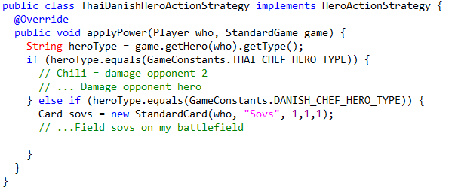
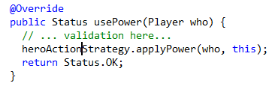
Compositional Variant
Example:
  GammaStone requirement: Heroes do different things
HotStone Framework Code:
GammaStone Delegates
ThaiDanishHeroStrategy
Notes:
Consider unit type switching code is present in the UnitActionStrategy

Slide 23
Compositional Variant
Example:
  GammaStone requirement: Heroes do different things
HotStone Framework Code:
GammaStone Delegates
What would Henrik say? Is this Parametric design???
ThaiDanishHeroStrategy
Notes:
Consider unit type switching code is present in the UnitActionStrategy

Slide 24
Compositional Variant
Example:
  GammaStone requirement: Heroes do different things
This is a much better design!
Why?
Because a) No hard binding in Game
b) GammaStone requirements are expressed explicitly in a single piece of code that bears the correct name!
HotStone Framework Code:
GammaStone Delegates
ThaiDanishHeroStrategy
Notes:
Consider unit type switching code is present in the UnitActionStrategy

Slide 25
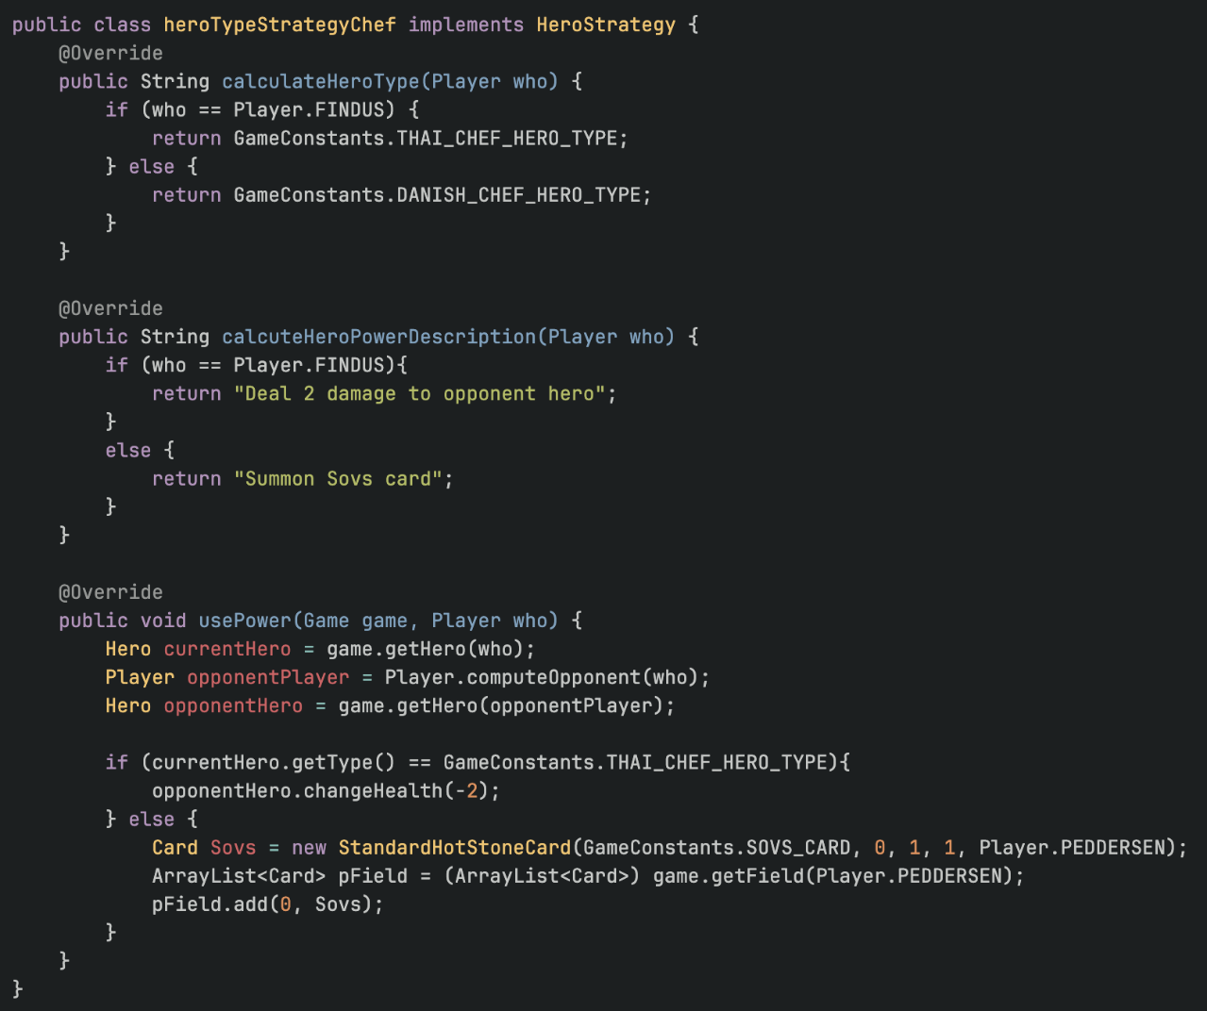
Example
From the trenches
But other issues
  Coupling is too
  hard…

Slide 26
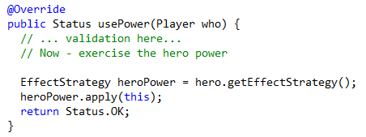
Compositional Variant
And you can avoid the switching completely
  Put the ‘power strategy’ into the Hero implementation instead; fetch it, and then apply it…
  Requires a ‘HeroBuildingStrategy’ to create the proper Hero types, then…
Critique: Approaching is a way to implement subclassing by hand ☺…

Slide 27
Inner and Outer
Keep inner code (framework code) clean of variability switching code; have it in the outer code (delegates)!
Delegates
HotStone Framework Code:
General Game implementation, general Hero and Card implementations
….
HeroAction
WinnerDetermination
WinnerDetermination
Closed for Modification
Open for
Extension

Slide 28
From Previous Years
Left for yourself to review…

Slide 29
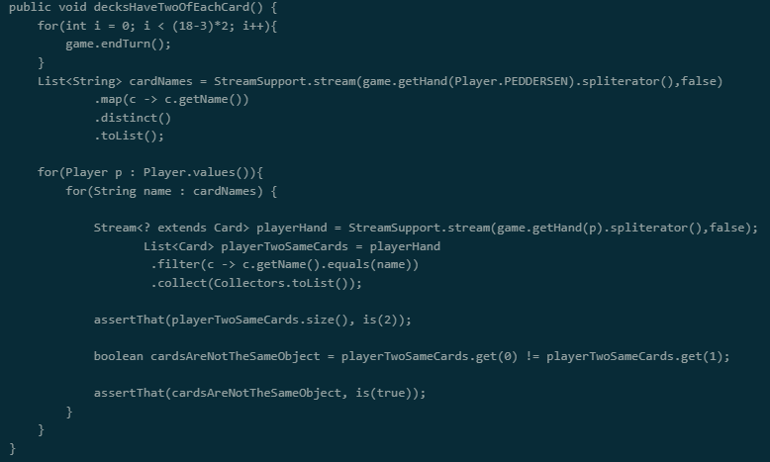
From the Trenches
Evident Test?
(No, it is
not all bad,
this, but…)

Slide 30
Recommendations
Use GWT
  Some parts are a bit obscure here
  // Given game has drawn all cards to the hand
  // When I select all cards of given name for given player
  // Then there are only two
  // Then the two cards are
  // unique references

Slide 31
Recommendations
If possible – use Unit Testing
  Deck building strategy can just return a list of cards
    And thus can be unit tested
      Ala: create deck strategy, get deck, test it
      No Game instance involved

Slide 32
Recommendations
Make private methods to do ‘One Level of Abstraction
  private List<Card> getAllCardsOfPlayerWithName(Player who, String name);

Slide 33
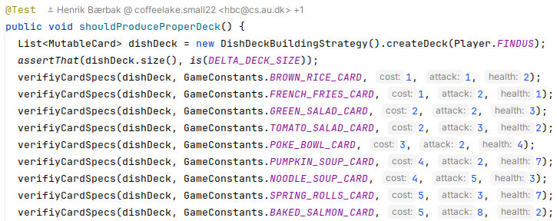
My Tests
Unit testing + private helper method.
Note! This is not how the first test case looked like; I have iterated on this test to clean up and make evident and do One Level Of Abstraction

Slide 34
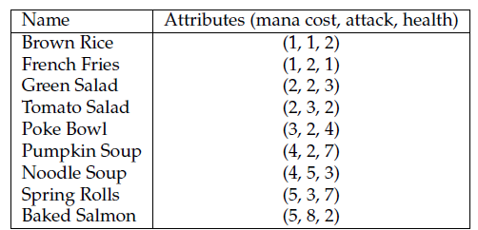
And note the ‘formatting’
Note! The visual layout of the test closely matches that of the tabular format, making x-checking it easy
  Analyzability

Slide 35
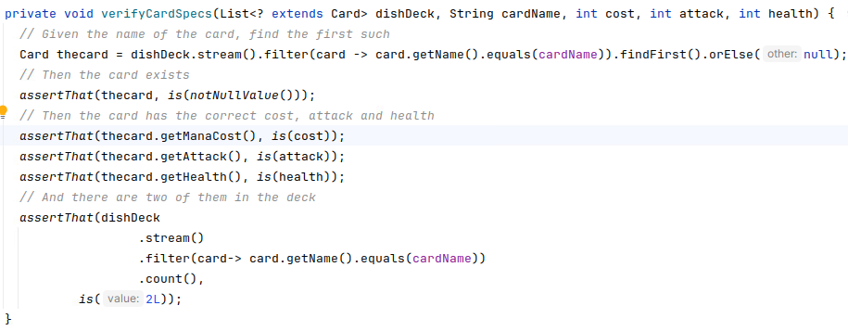
The Verify method
Looks like

Slide 36
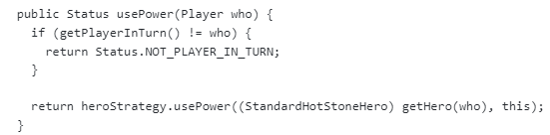
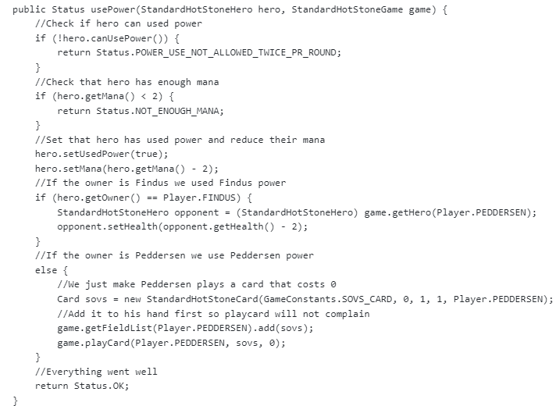
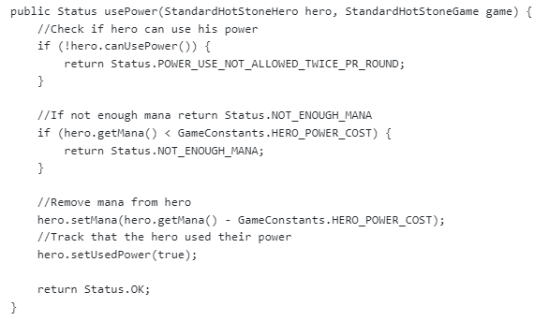
Single Responsibility
Who is responsible for validating game rules? Game!
What is wrong?
Alpha
Gamma

Slide 37
Single Responsibility
Here: Game does half, Strategy does half of validation ☹
Result
  Code duplication
  Validation in two places
Alpha
Gamma
ISO 9126: Stability and Changeability capabilities are suffering ☹

Slide 38
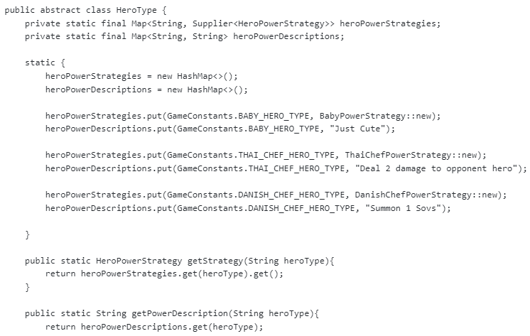
Another Attempt
Game has this ‘configuration’ of heroes’ Power…
Drawing from a
single ‘HeroType’
Pro/Cons?
Notes:
Not ‘change by addition’ as HeroType has to be modified over and over again; Cohesion problemer, da Hero’s power nu er spredt i tre klasser: Game, HeroType og de enkelte strategier.
Men fordelen er at der ingen parameterisering er i game

Slide 39
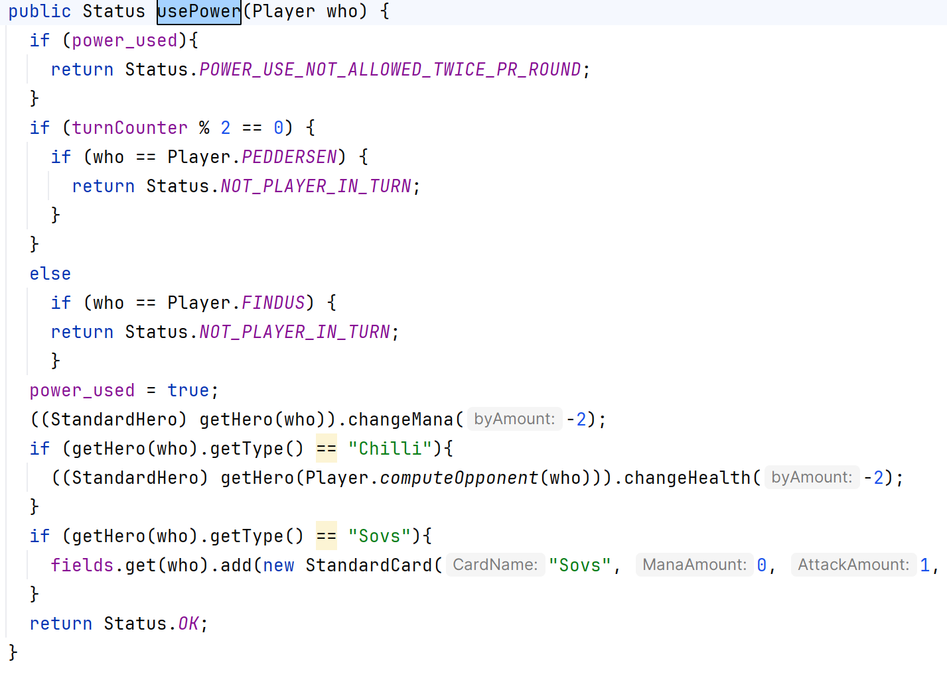
Variability Technique Used?
What about this one? From the ‘StandardGame’
Notes:
Parametrisk løsning.

